Slide 1
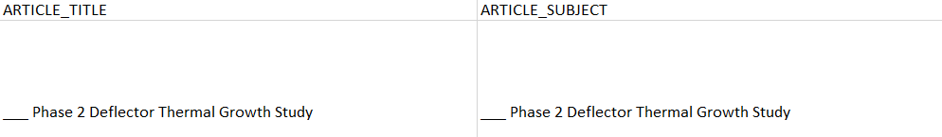
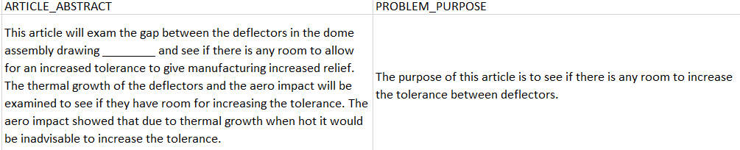
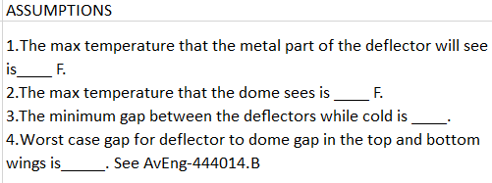
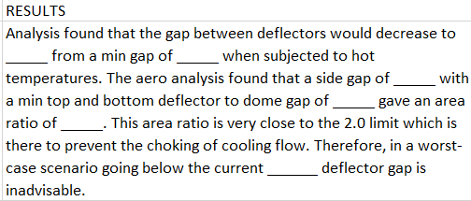
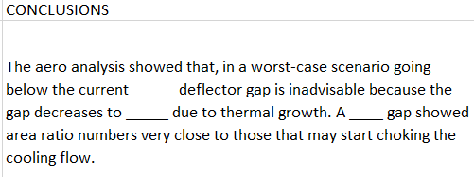
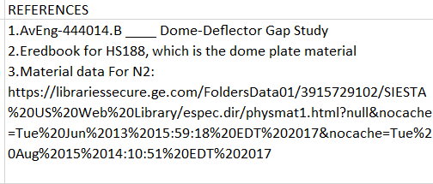
What is a Design Record Book (DRB)?
Design Record Books are written documents of a design study like the one written to the left.
They have extensive text with an abstract, problem, assumptions, results, conclusions and references. (under scroll areas are text that are intentionally removed for public viewing)
These documents have to be export controlled with export classifications like NLR (no license required) or LRS (license required state), etc.
These export classifications can be derived from the text with natural language machine learning techniques.

Slide 2
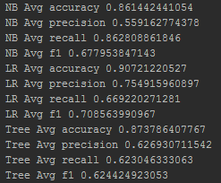
Natural Language Filters Used/Tried.
Libraries/Algorithms used/tried.
Filtered out “English stopwords”
Filtered out words that occur only once in the data – removes potential typos
Filtered out words that occur more than 40% of the articles – removes other common word
Filtered out abbreviations and replace them with their actual words
Remove all digits that are stand along and not mixed with letters like part number and drawings are. Example: 2343M43P01 will not be filtered out because there are letters in it.
Remove all articles with the words below:
'to be added by custodian none’
'no design summary none’
'digitized paper study'
Libraries used – Sk.learn
Preprocessing - Document-term matrix methods used.
Count Vectorizer and TfidfVectorizer tried - Count Vectorizer used.
Feature reduction methods tried:
Truncated SVD
Chi2
Classification Algorithms:
Naïve Bayes
Decision Tree
SVC
GradientBoost
LinearSVC
Logistic Regression
Early Results and Algorithms Tried
These are the results of 5 kfolds
Initial classification is only on 2 classes (binary)
Accuracy/ precision/ recall need to be near 100 % in order to be used.
Logistic regression seems best at first.

Slide 3
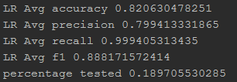
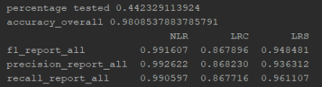
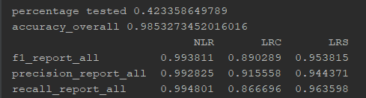
Focusing on a population can potentially be used, which has a almost 100 % accuracy.
Reducing the overall population to a smaller percentage of the population that produces a much more high recall score.
Logistic regression was used, grid search was used to optimize.
Very high recall score, means almost no release of LR data.
Only tested on ~19% of the test population
Tried to do multi-classification, on three classes, NLR, LRC and LRS
Used some feature reduction/selection algorithms like Ch^2
Used linear SVD for final classification
Used grid search to optimize.
Results are below.
Used Ch^2 to select a subset of features
Used linear SVD and selected a C of .045 which also selects a subset of features.

Slide 4
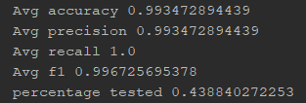
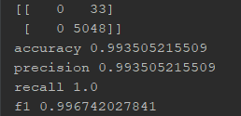
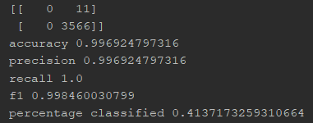
One Class Classification
Using Chi2 for feature reduction (n = 5500) then only classified using linear SVM (c = .02) when the probability for NLR was above 96%.
To simulate results if this algorithm was utilized from 8/01/2017 to present. (Training Data is made up of past to 8/01/2017 and Testing Data is made up of 8/01/2018 to present.
One class classification: Article only gets classified if probability for NLR (no license required class) is > 96%.
Results show that accuracy is very high and a large amount of the articles are able to get classified.
Average of 5 kfolds.
Example of one of 5 kfolds.
Confusion matrix, only one class gets classified.

